Slide 1


Department of Computer Technology
Session 2021-2022 (Even)
VI – SEMESTER
CT 2364: LAB:
Internet of Things

Slide 2
Experiment No.- 4
Installation of ESP32 board and testing the installation by interfacing LED

Slide 3
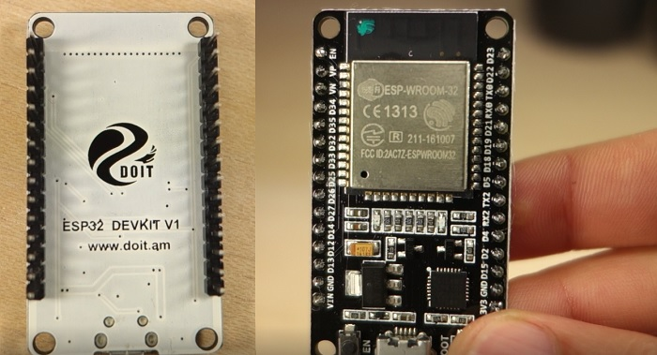
ESP32 DEVKIT DOIT board

Slide 4
ESP32 DEVKIT DOIT board
Specifications
When it comes to the ESP32 chip specifications, you’ll find that:
The ESP32 is dual core, this means it has 2 processors.
It has Wi-Fi and bluetooth built-in.
It runs 32 bit programs.
The clock frequency can go up to 240MHz and it has a 512 kB RAM.
This particular board has 30 or 36 pins, 15 in each row.
It also has wide variety of peripherals available, like: capacitive touch, ADCs, DACs, UART, SPI, I2C and much more.
It comes with built-in hall effect sensor and built-in temperature sensor.

Slide 5
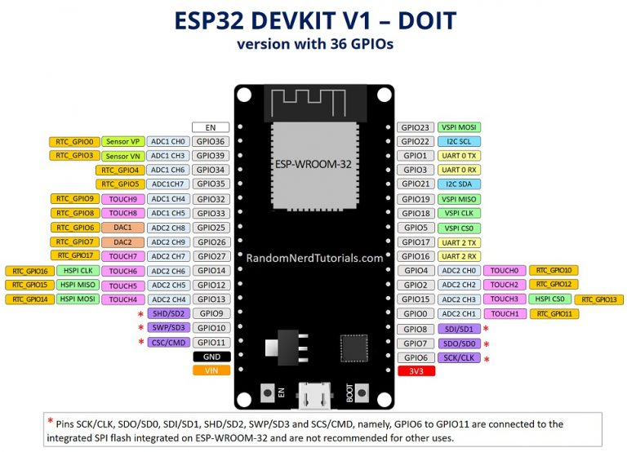
ESP32 DEVKIT DOIT board

Slide 6
/*
Blink
*/
// ledPin refers to ESP32 GPIO 23
const int ledPin = 23;
// the setup function runs once when you press reset or power the board
void setup() {
// initialize digital pin ledPin as an output.
pinMode(ledPin, OUTPUT);
}
// the loop function runs over and over again forever
void loop() {
digitalWrite(ledPin, HIGH); // turn the LED on (HIGH is the voltage level)
delay(1000); // wait for a second
digitalWrite(ledPin, LOW); // turn the LED off by making the voltage LOW
delay(1000); // wait for a second

Slide 7
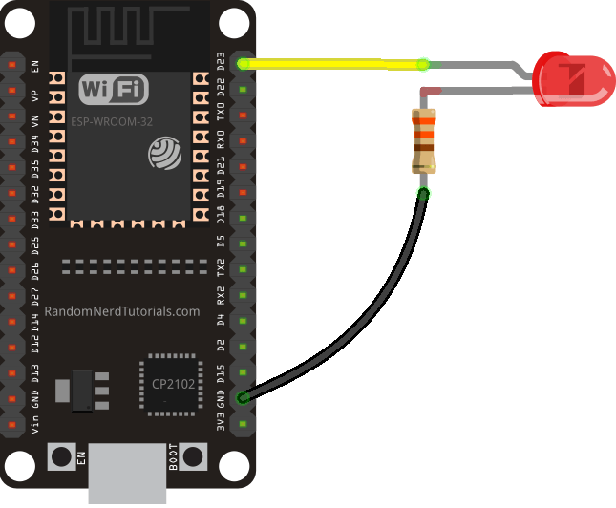

Slide 8
THANKS

